Slide 1
OT Security Capabilities
Shekarayya Hiremath
ICS/OT & IoT Security
July 2021

Slide 2
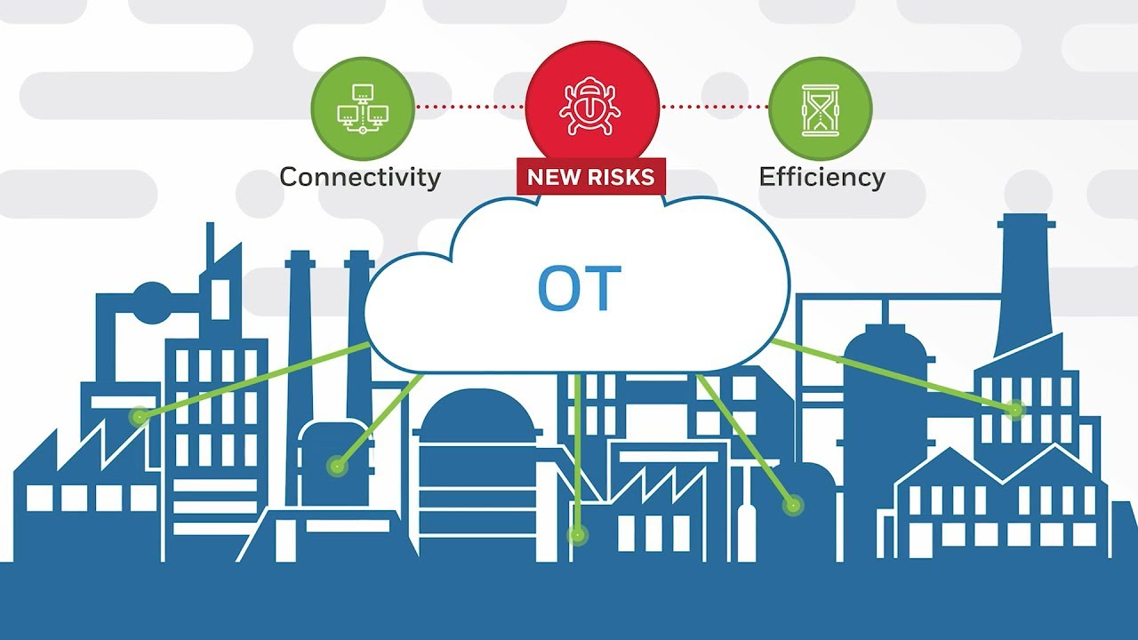

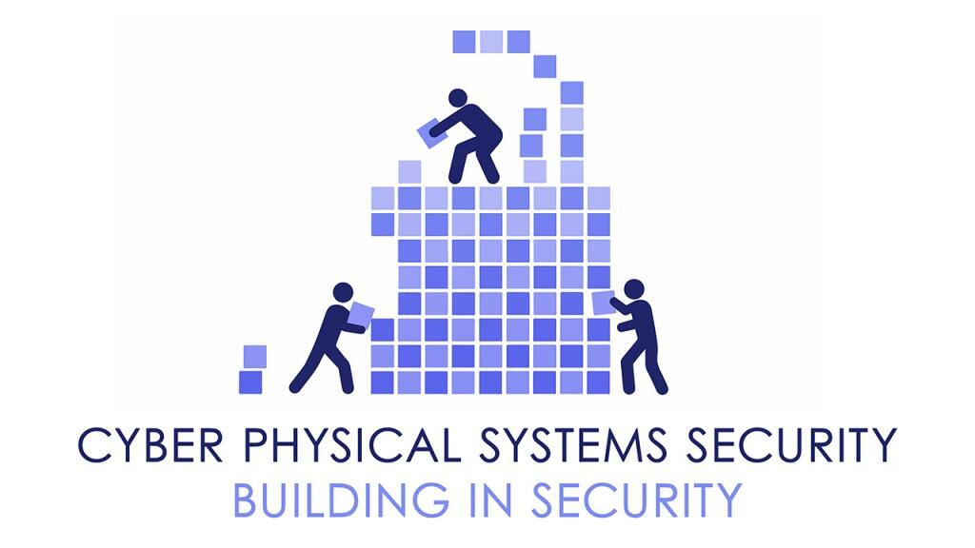
OT & IoT Security Practice
IoT Security
OT Security
Cyber-Physical Security
Scope of services delivered across all sub-practices
Risk Assessment
Strategy & Technology Consulting
Architecture
Engineering
Systems Integration
Implementation
Operations
Managed Services

Slide 3
COMPANY’s OT Security Service offerings
OT Security Consulting & Advisory
Site/Plant assessments
OT Security architecture review & Roadmap preparation
Visibility:
Asset & Network
Asset detection & management
Automated Vulnerability identification
Prioritization of vulnerabilities
Secure Remote Access
OT SOC
Full visibility into all OT activity, asset details, network behavior
Network communication visibility
Vulnerability Identification
Anomaly Detection
Threat Advisory
OT Security Awareness Workshops
Maturity assessments
Use Case & Workflow Design
Network Segmentation
Analyze network traffic flow
OT Security Incident Monitoring & Response
Design & Review network architecture as per industry standards like IEC 62443
OT Firewalls : Implementation & Support
OT logs integration with SIEM
Implementation & Support
Integration with SIEM
Use case development

Slide 4
Delivering Company’s approach to OT & IoT Security
At Company we bring together an end to end capability blending practical industry and relevant consulting and engineering experience that enables our clients to achieve sustainable improvement in Industry 4.0 security
Identify
Detect
Protect
Respond
Recover
Self assessment
On-site or remote assessment
Stakeholder interviews
Automated asset detection using tools
Analyze asset base and identify risks using tools
Review existing governance and business operating model
Develop OT & IoT Security strategy and Roadmap
Develop OT & IoT Security Controls framework
Design OT & IoT Security Architecture leveraging tools
Design new Target Operating Model
Implement OT & IoT Security transformation roadmap
Deploy OT & IoT Security Architecture
Implement OT & IoT Security governance model
Implement OT & IOT Security target operating model
OT & IoT Security Operations & SIEM
OT & IoT Asset inventory management
OT & IoT Security Controls monitoring
OT & IoT Assurance reporting
SIEM & SOC
Alerts & Analysis
Cyber Threats
Policy
Maturity
Vulnerability Management
Risk
Standards
Impact
Likelihood
Guidelines
Towards Success
Compliance
OT Assets

Slide 5

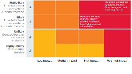

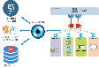
Site Assessment Phases
Pre-Assessment
Site Security assessment
OT Site security assessment
Report & Actions
Planning
Resource mobilization
Kick-off workshop to finalize scope and identify the sites
Remote workshop with client and site SME to understand the site networks
Checklist & Questionnaire
Conducting assessments focusing on site environment vis a vis OT security measures
Interviews with stakeholder to understating existing processes and landscape
Refer industry IEC 62443/ NIST SP 800-82
Prepare passive discovery procedure
Conducting specific assessments based on network architecture, anti-malware infra etc.
Non-Intrusive scanning
Identify active assets, traffic, ports and protocols being used
Review for any gaps in Asset Inventory identifying risks noted within the analysis
Consolidated identified vulnerabilities and;
identify risk mitigation plan
Asset inventory dashboard created for selected site
Asset Vulnerabilities findings
Document key findings, vulnerabilities & actions
OT Network communication path
Suggest next steps & proposed remediation roadmap
Recommendation & Best Practices

Slide 6
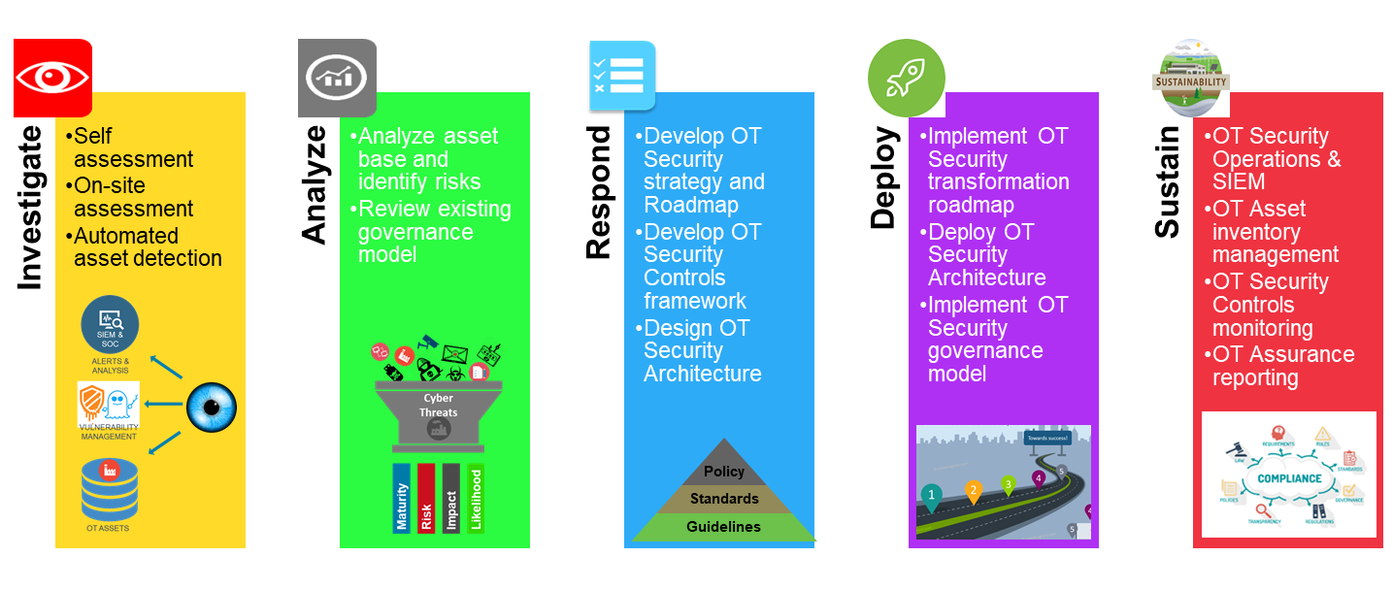
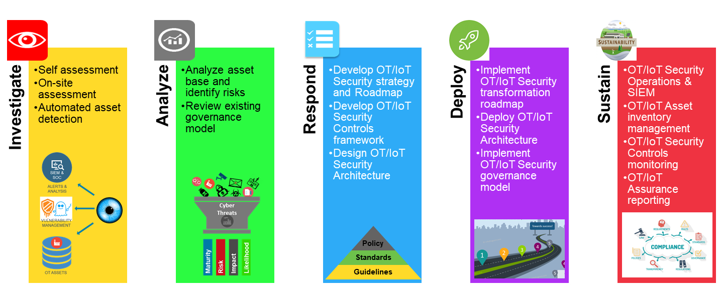

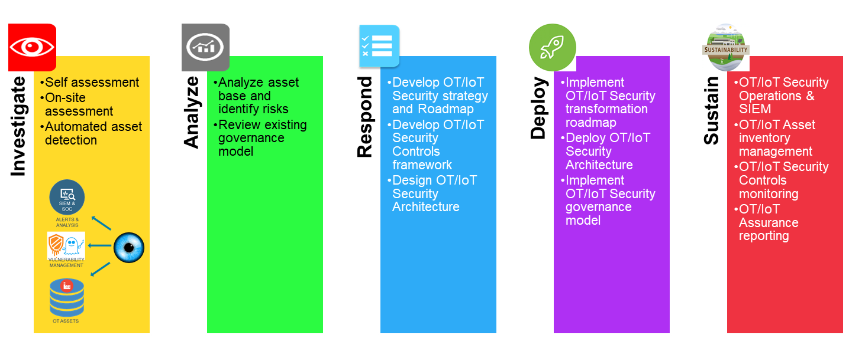
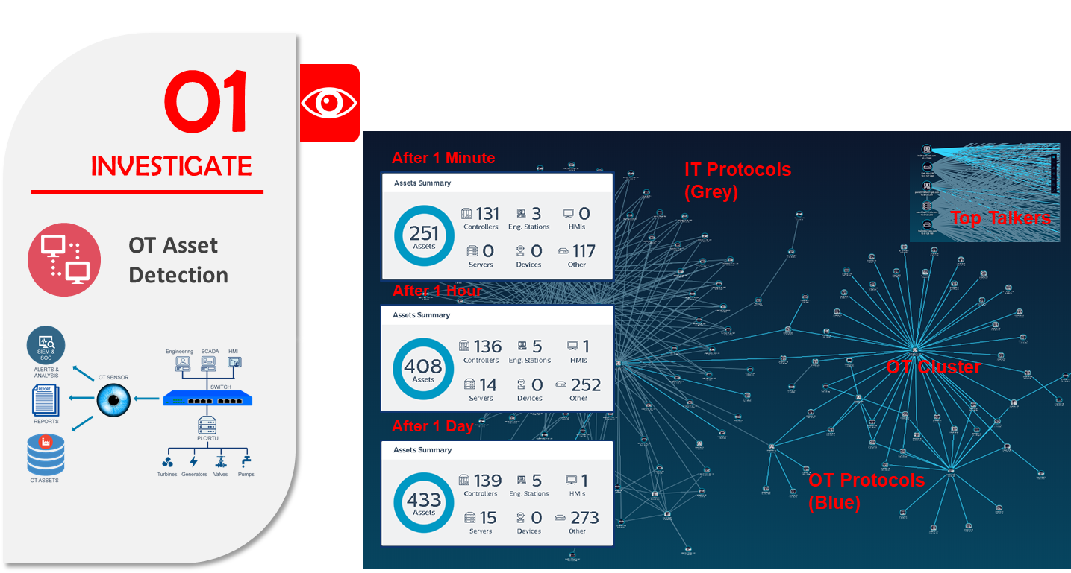
OT asset discovery, inventory creation & risk analysis
[insert client name] wishes to obtain a clear understanding of OT/IoT assets across a nominated sample of 3 sites and identify the risks associated with the assets through establishment on a global OT/IoT asset inventory and vulnerability assessment.
[insert client name] is therefore seeking an experienced partner to assist develop this OT/IoT asset inventory and assess the current cybersecurity posture of the OT/IoT environment assets whilst preserving the operational integrity of the OT/IoT environment leveraging a combination of passive scanning, policy and process review and where required physical site visits.
The Company team will therefore adopt the following phased approach to the planned engagement.
Due Diligence
Integrated Asset Inventory dashboard created for sites reviewed
Plan & Design
Asset identification & OT/IoT risk analysis
Report & Actions
Kick-off workshop to finalize scope, sites and assets
Identify the SPOC for each physical site
Connect sensors and packet capture tools to the identified ports
Workshop with client and site SPOCs to understand the existing network and network topology
Identify the locations, span ports and tools for connecting the passive discovery sensor
Create plan for deploying the technology sensor
Network ports, capture tools, duration etc. are finalized
Change management process initiated for connecting sensor at each connection point
Prepare passive discovery procedure
Finalise deployment/visit schedules (including time for technology changes and travel between sites)
Monitor and collect the traffic packets
Run the traffic packets in the tool and create the complete asset inventory
Review for any gaps in Asset Inventory
Fine-tune the tool/ Manual entry
OS patches compliance and risk vulnerability report is generated
Submit network topology and architecture document
Document key findings, vulnerabilities & actions
Suggest next steps & proposed remediation roadmap
Project close workshop to present findings and discuss next steps/future phases of support (as required)

Slide 7
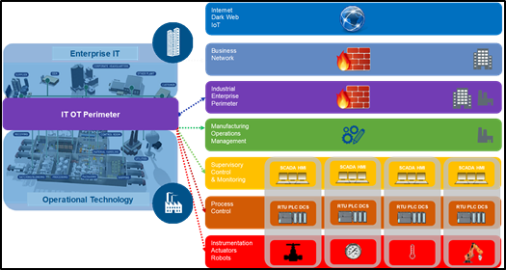

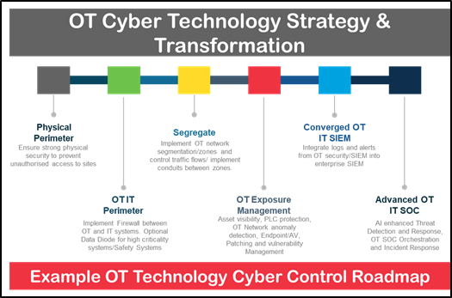
Establishing an integrated cyber approach to OT Security
At Company we blend our industry, consulting and technology engineering experience together to form a capability that enables our clients to achieve sustainable improvement in OT security through an end to end integrated approach.
Our initial focused phases (Investigate & Analyze) assist organisations to exhaustively understand and document their OT asset landscape and then assess the risks associated.
We then work with our clients, based on their risk tolerances and compliance burdens to define an OT Cybersecurity strategy and roadmap defining the new enterprise/solution architectures and remediation required to address identified risks.
Once the deployment stage has commenced we concurrently assist our clients through transition to sustainable managed services, initially focussed on OT Security, but then leveraging existing IT Security operations to establish an Integrated IT/OT Security Operations Centre.

Slide 8
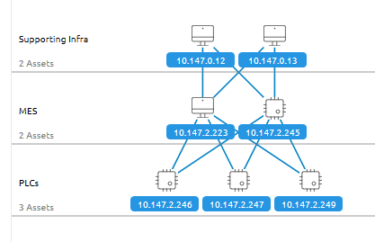
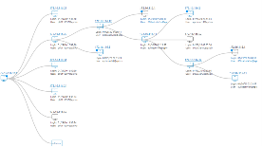
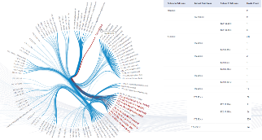
Assessment Deliverables
Asset
Vulnerabilities
Findings
Asset Inventory
Details
OT Network
Communication
Pattern
Recommendations
and
Best Practices

Slide 9
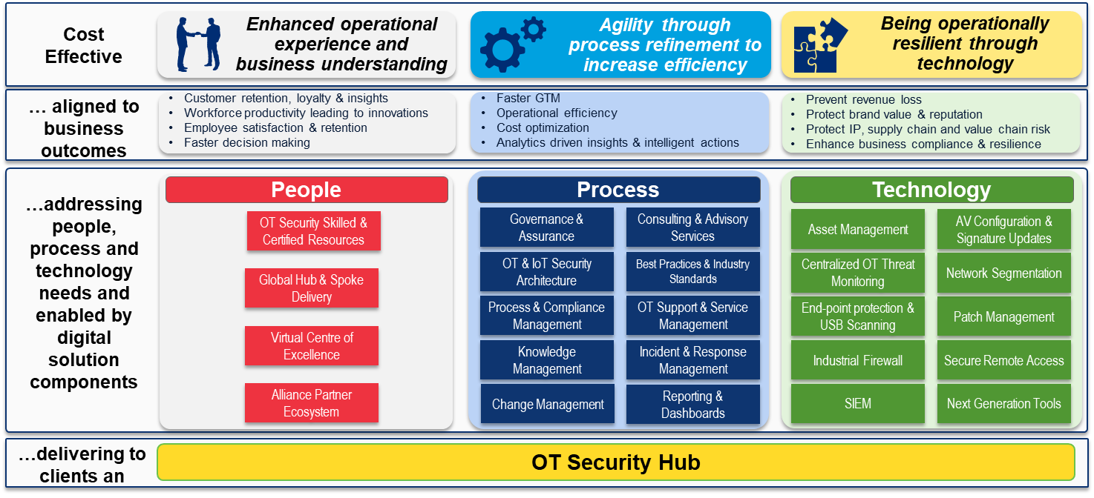
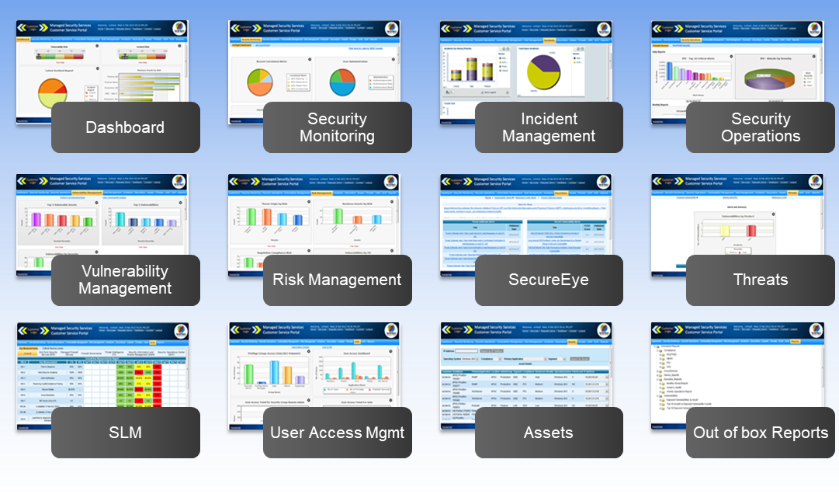
OT Security Managed Services
Assisting our clients achieve sustainable management of the risks of OT & IoT cybersecurity in their organization through
Advanced Security Operations enabling detection, protection and response to OT & IoT Cyber threats:
Security Incident & Event Management
Security Operations Centre
Security Orchestration
Managed Firewall, Endpoint, Gateway and Edge
Cyber Threat Intelligence
Patch Management
Service design, build and operate of advanced OT& IoT Cybersecurity Services and Operations including Continuous L2 Control Monitoring of OT & IoT Assets
Benefits include:
Global coverage
Industrial Cybersecurity Expertise
Scalable and efficient managed services
Rapid Transformation of IT SOC into OT & IoT centric Cyber operations through advanced orchestration
OT-IT Centralized SOC

Slide 10
COMPANY’s Global OT Cybersecurity Hub Model
Cost
Effective
Enhanced operational experience and business understanding
Agility through process refinement to increase efficiency
Being operationally resilient through technology
… aligned to business outcomes
Customer retention, loyalty & insights
Workforce productivity leading to innovations
Employee satisfaction & retention
Faster decision making
Faster GTM
Operational efficiency
Cost optimization
Analytics driven insights & intelligent actions
Prevent revenue loss
Protect brand value & reputation
Protect IP, supply chain and value chain risk
Enhance business compliance & resilience
…addressing people, process and technology needs and enabled by digital solution components
People
Process
Technology
OT Security Skilled & Certified Resources
Governance & Assurance
Consulting & Advisory Services
Asset Management
AV Configuration & Signature Updates
OT & IoT Security Architecture
Best Practices & Industry Standards
Centralized OT Threat Monitoring
Network Segmentation
Global Hub & Spoke Delivery
Process & Compliance Management
OT Support & Service Management
End-point protection & USB Scanning
Patch Management
Virtual Centre of Excellence
Knowledge Management
Incident & Response Management
Industrial Firewall
Secure Remote Access
Alliance Partner Ecosystem
Change Management
Reporting & Dashboards
SIEM
Next Generation Tools
…delivering to clients an
OT Security Hub
Notes:
OT Cybersecurity Hub model is used to deliver the services for our customer based on 3 key pillars i.e. People, process & Technology. COMPANY’s services are blended by providing consulting/architecture, secure engineering, deployment and maintenance/support. This cyber Hub refers to IEC 62443 standards to provide OT security services.

Slide 11
Key Case Studies

Slide 12

Case Study >> Vertical
SCADA Cybersecurity Risk Assessment
Global Medical Devices Manufacturing organisation
Challenges
Solutions
Value Delivered
Cybersecurity risks inherent in OT could impact their critical Industrial operations
Need for a ICS ISMS framework
Difficulty in implementation of Cybersecurity framework for ICS
Foundation for Industry 4.0
Self Assessment of 50+ Sites and Local Onsite Assessment of 5 Manufacturing Sites
Risk Assessment & Analysis
Actionable Strategy and Roadmap for Board
Analyze questionnaire findings from all sites and Deep dive assessment of 5 sample sites
Tool based Automated Industrial asset and traffic inspection to accelerate the assessment
Design and Implementation of Cyber Risk Management Model – ICS ISMS
Cybersecurity framework aligned to international standards, IEC 62443
Timeline and work plan to implement the framework and operating model
Defined activities, priorities, resource, RACI, & timescales
Clear understanding of the cyber risks
Structured plan to remediate and manage them in an ongoing process
ICS Cybersecurity Framework to manage OT Cyber risk including; Governance, Organization, Ownership, Policy, Controls
Prioritized roadmap for implementation.
Collaboration between IT and OT teams
Provides a solid foundation for the implementation of future initiatives such as Industrial IoT and smart plants

Slide 13

OT Cyber Security & Enterprise Architecture Program
Gold and Base Metal Company
Challenges
Solution Highlights
Value Delivered
Less visibility on cybersecurity posture of Gold and Base Metal Operations.
Identify challenges and opportunities in line with business goals and suggest possible solutions
Identify high level risks and challenges in the current technology infrastructure
Lack of visibility for connectivity between IT & OT network
Provide a high level plan and roadmap for enhancing data management capabilities to support decision making.
A team of COMPANY experts from all Domain Including OT working on site in KSA and remotely for 3 months to design and document an integrated IT OT ISMS, complying with both ISO 27000 and IEC-62443 and designed OT cyber standards.
COMPANY referred industry standards and best practices for this assessment.
COMPANY provided the roadmap to customer that help them to mitigate the cybersecurity risk.
Designed and documented a OT Cyber Security Management Systems and operating model.
Delivered OT/IT integration and control implementation plan to meet all the business requirement.
Prepared the Perdue model security control document based on the OT security frameworks. (IEC-62443 and SABSA)
Put an appropriate model in place for both the office and the plant environments and had the flexibility to address different business priorities, challenges and levels of risk in each.

Slide 14

Case Study >> Vertical
Industrial OT Threat Monitoring
Global science-based company active in health, nutrition and materials manufacturing
Challenges
Solution Highlights
Value Delivered
Implementation of OT Cyber security program at manufacturing sites
Global network wide implementation of monitoring probes to cover all the manufacturing sites(East-West)
Adding an OT monitoring capability to complement existing IT monitoring capabilities by integrating solution into existing IT/OT processes, technology and service provider landscape
OT Cybersecurity solution integration with SIEM(Splunk)
COMPANY supplied, designed, implemented and tested monitoring solutions for the OT landscape.
Handling OT monitoring operations for 128 manufacturing sites across 30+ countries globally.
Leveraged Nozomi Networks for OT monitoring solution
Also integrated OT logs into SIEM ( SPLUNK)
Remote implementation to aid current COVID situation
Hybrid implementation approach : an amalgamation of Agile and Waterfall for robust roll out across 128 manufacturing sites.
Rapid deployment of OT monitoring capability, while avoiding the extended duration and cost associated with achieving full coverage of al OT networks for each site.

Slide 15

Establishing Zero Trust and
Network Segmentation in MedTech
Global MedTech Manufacturing
Situation & Challenges
Solution Highlights
Value Proposition
Client desire to conduct a Global IT optimisation program (including Factory/Production IT)
Existing factory/production technology operational on a single network alongside traditional Enterprise IT with no segmentation in place
Client had a self-admitted low level of security maturity, with cybersecurity focus on Enterprise IT and limited to no knowledge of OT Security
Healthcare globally is the #1 attacked vertical by cyber-criminals and the client is at the heart of technology innovation in Healthcare
Core Enterprise IT and production technology largely legacy in nature and not aligned to technology innovation
COMPANY undertook site assessments to document and assess the current state architectures, define and document the new target reference architecture and derive the remediation and implementation roadmap
COMPANY architected a defence in depth and “zero trust reference architecture” that will segment the Enterprise IT and Factory/Production IT environments
Reference architecture blueprints developed with future state CISCO technology in mind and enabling scalability and technology advancement as a central tenet of larger global infrastructure and security remediation program
Highly experienced industry focused team undertook assessment to identify current state and maturity gaps requiring remediation to deliver enhanced cyber resilience
Advanced zero-trust reference architecture designed delivering rapid security enhancements
Standardized enterprise architecture delivering trusted zones and active network segmentation
Delivery of rapid remediation to all global sites on topic of Factory/Production IT
New target operating model and governance/policy system established to coordinate future state architecture
Notes:
Olympus - Japan

Slide 16

Case Study >> Vertical
Vulnerability Management of IT and OT environment
Oil and Gas Company, Australia
Challenges
Solution
Value Delivered
No view of vulnerability of OT assets
Control systems and controllers from a variety of vendors
Unprotected SCADA, PLC & field interface devices
Absence of management of actions to be taken on the vulnerabilities found on OT and IT network
Integration needed with various security tools (McAfee SIEM, Indegy sensor, Qualys scanner)
Vulnerability detection through OT sensor (Indegy) on the control network
OT sensor configured to monitor any anomaly from the baseline network traffic and send to McAfee SIEM and Skybox
Integrated Skybox vulnerability management tool to get vulnerability data from WSUS and Qualys scanner
Firewall integration and threat modelling using Skybox
Vulnerability lifecycle management through Skybox ticketing tool
Provide a single pane of glass view for OT/IT vulnerability, threat and risk status
Help in deciding the action to be taken (IPS rule, patch or upgrade) based on risk level (CVSS score, exposure, exploitability and asset importance)
Efficient and productive security operations, based on network traffic baselining and monitoring.
Reports to track weekly, monthly and quarterly status (open, close, work in progress) and criticality of vulnerabilities
Notes:
Inpex- Australia

Slide 17

Cyber Security Risk Assessment, Identification And Recommendation For OT and IT Network
Textile Plant Of An Indian Multinational Conglomerate
Challenges
Solution
Value Delivered
Lack of knowledge about business risk through security vulnerabilities available on the control system network/equipment
Control systems and controllers from a variety of OEMs/vendors
OT security risk assessment through standards (NIST) based questionnaire to assess security risk and business risk
Discussion with key stakeholders across various department in the plant to understand and cover overall risk
Network analysis and Vulnerability detection through on-site data capture and off-site analysis of the data through SCADAFence tool
Provide security risk profile of the plant, based on standards based questionnaire and SCADAFence tool
Roadmap for implementation of a robust security infrastructure for the plant
Roadmap includes defining and implementing OT security policies, IT and OT network separation, use of tools to automate security process and implementation of security operation center (SOC).
Notes:
ABG - India

Slide 18
OT & IoT Security L1 Solution Description

Slide 19
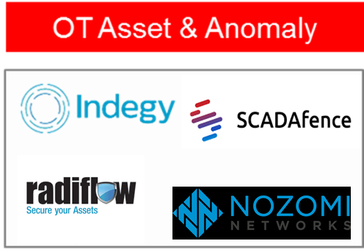

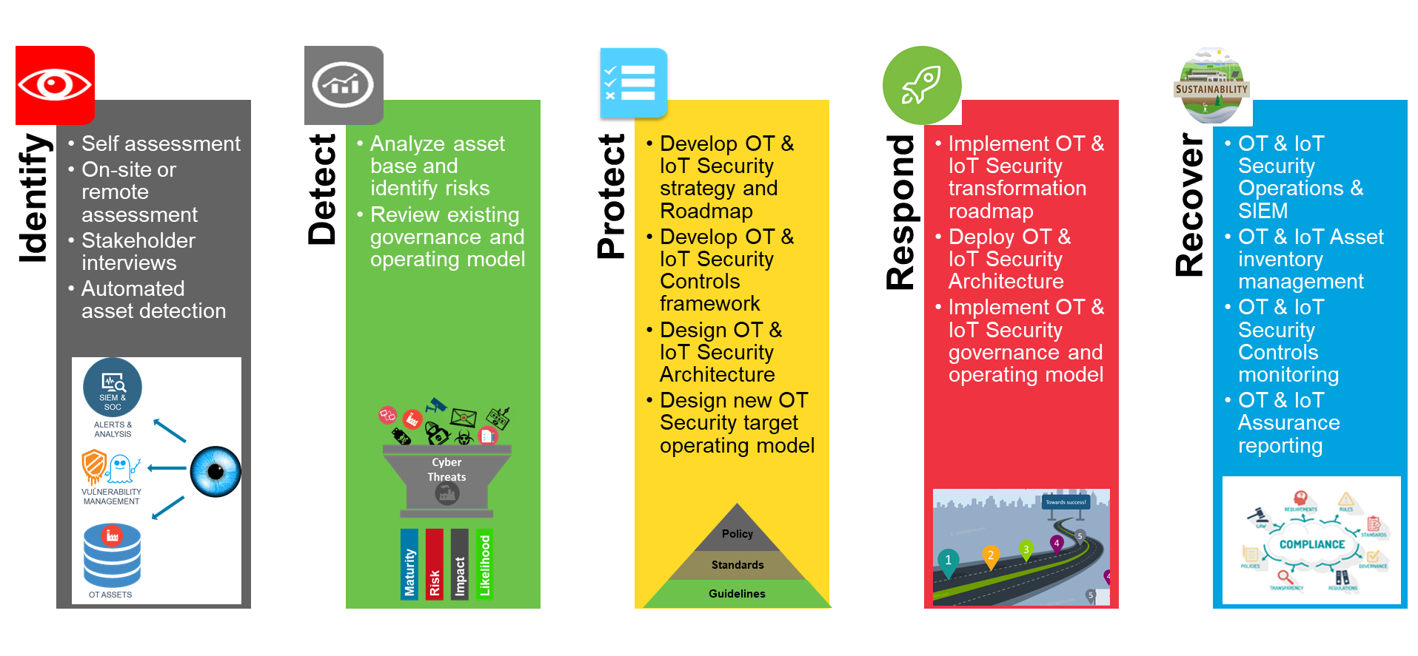


Our OT & IoT Security Services – Phase 1 – Identify
Assisting our clients identify, qualify and quantify the risks of OT cybersecurity in their organisation:
Our OT & IoT asset scanning devices are designed specifically for OT environments and are NOT traditional IDS
Recognizing the sensitivity and continued need for availability in OT & IoT environments the sensors conduct passive deep packed inspection using a methodology specifically designed for ICS networks
The sensors will provide full visibility into all OT & IoT activity assuming logical connectivity can be established, including unique visibility in the control-plane
Real-time alerts on suspicious and unauthorized access can be provided to controllers
Comprehensive audit trail to ensure sustainable control and compliance objectives can be achieved
Notes:
The first step for an organisation in addressing the OT & IOT Security challenge is to identify the technology landscape and operating environment. At Company we have established alliances and vendor partnerships with all the major OT & IoT Security vendors (over 40 technology partnerships) with a view to being able to assist our clients to identify, qualify and quantify the risks of OT & IoT Cybersecurity in their organisation.
It is imperative to note that traditional enterprise IT security solutions cannot be leveraged in the OT & IoT Security environment such is the proprietary and sensitive nature of the technologies being discovered and assessed and therefore our tools and methodologies have been specifically designed for Industrial Control System (ICS) networks.
Appropriately deployed these sensor technologies can provide unparalleled visibility into the OT & IOT environment across the relevant infrastructures including the control plane and delivering real-time alerts on suspicious access as well as comprehensive audit trail of compliance objectives and administrative actions across the OT & IoT technology environments.

Slide 20

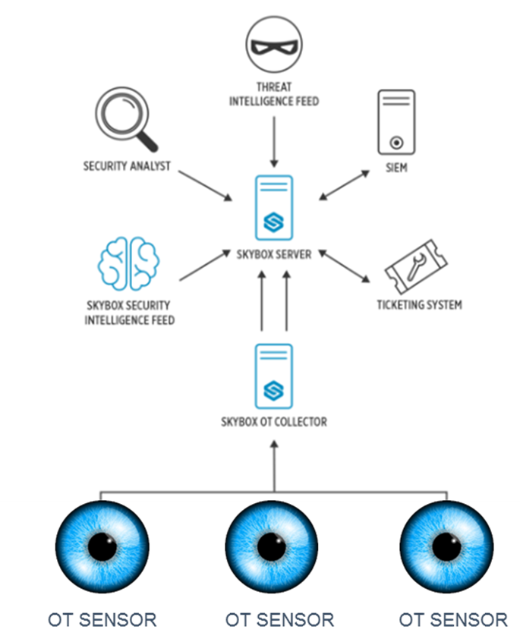
Our OT & IoT Security Services – Phase 1 – Identify
Assisting our clients identify, qualify and quantify the risks of OT & IoT cybersecurity in their organisation:
Our integrated security management platform from Skybox extends security management capabilities from your IT network to operational technology (OT & IoT) environments
This enables you to gain seamless visibility across your OT, IoT & IT network and manage security from one centralized platform.
With comprehensive network modeling, Skybox gives you detailed path analysis and fast insight to vulnerabilities and exposures anywhere in your organization.
The Skybox solution provides “on-demand, contextual intelligence” which helps you better prioritize risk to secure the network, improve uptime and avoid potentially dangerous disruptions in critical infrastructure organizations.
Integrates with OT & IoT Sensors from Indegy, Claroty, Nozomi Networks and many more used to initially scan for OT & IoT assets
Notes:
Furthermore, leveraging our strategic alliance with Skybox we are able to offer our clients a converged approach and understanding of their overall technology risk presenting the risks associated with OT & IoT Security alongside traditional cybersecurity risk reporting. This is a key concern to the majority of organisations where previous approaches were centred around security by “air gap” and security by obscurity, however the WannaCry and NotPetyaWare malware events of 2017 showed the flaws of this approach and the disruption that can result from not understanding the converged technology risk within an organisation.
Skybox performs the role of a systems aggregator and enables the automated connection of over 130 cybersecurity and technology solutions that holistic provide an unprecedented view of the overall security posture of all aspects of technology within an organisation.
This enables an enterprise to gain seamless visibility across your OT, IoT & IT networks and manage security from one centralized platform and with comprehensive network modeling, Skybox provides detailed path analysis and fast insight to vulnerabilities and exposures anywhere in the organization.
Furthermore, the Skybox solution provides “on-demand, contextual intelligence” which assists better prioritize risk to secure the network, improve uptime and avoid potentially dangerous disruptions in critical infrastructure organizations.

Slide 21
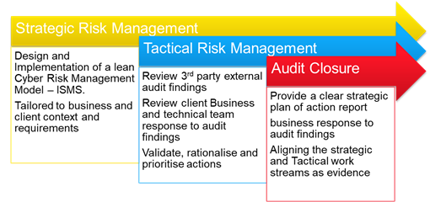
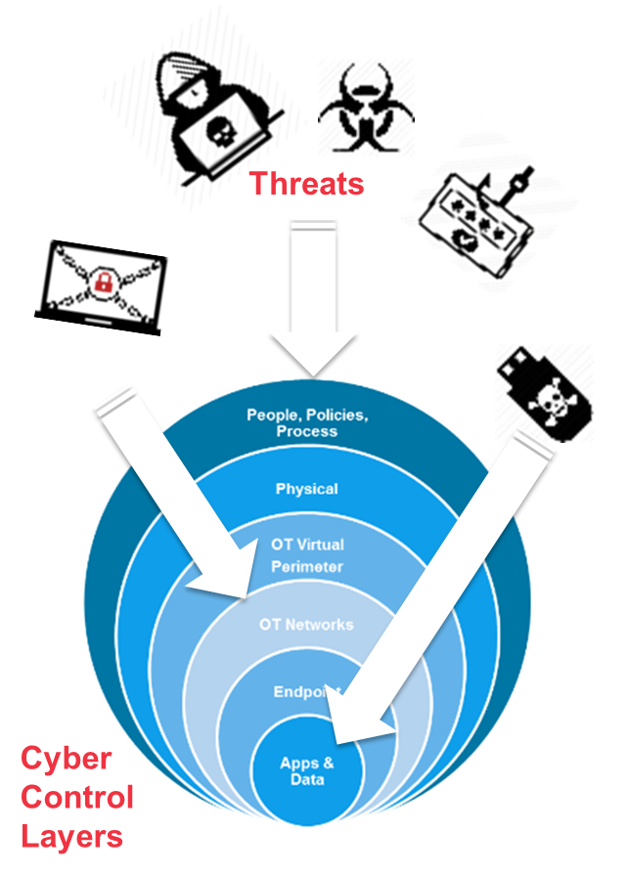
Our OT & IoT Security Services – Phase 2 – Detect
Assisting our clients analyse the risks in the OT & IoT landscape and collaborate on design of a proportional prioritised response
Post identification of the OT & IoT landscape, our experienced OT & IoT Security architects and engineers can assist our clients analyze the inherent risks across the spectrum of OT & IoT Cyber Control layers:
Applications & Data
Endpoint/Edge computing
OT & IoT Networks
OT & IoT Virtual Perimeter
Cyber Physical
People, policies and process
This analysis will help derive an agreed understanding of the strategic and tactical risks faced by the organisation and can be delivered to meet internal assurance objectives
Notes:
Once we have assisted our clients discover the OT & IoT environments it is imperative that organisations understand the cybersecurity risks associated as well as the governance and compliance risks. Understanding this risk landscape will enable collaboration on the design of a pragmatic and proportional prioritised response and leverage consulting and technology solutions in tandem with OT & IoT Security engineering and architecture.
Post identification of the OT & IoT landscape, our experienced OT & IoT Security architects and engineers can assist our clients analyze the inherent risks across the spectrum of OT & IoT Cyber Control layers:
Applications & Data
Endpoint/Edge computing
OT & IoT Networks
OT & IoT Virtual Perimeter
Cyber Physical
People, policies and process
This analysis will help derive an agreed understanding of the strategic and tactical risks faced by the organisation and can be delivered to meet internal assurance objectives. Fulfilling the IDENTIFY and DETECT phases are fundamental components of a meaningful response to the OT & IoT Security challenge faced by client organisations.

Slide 22
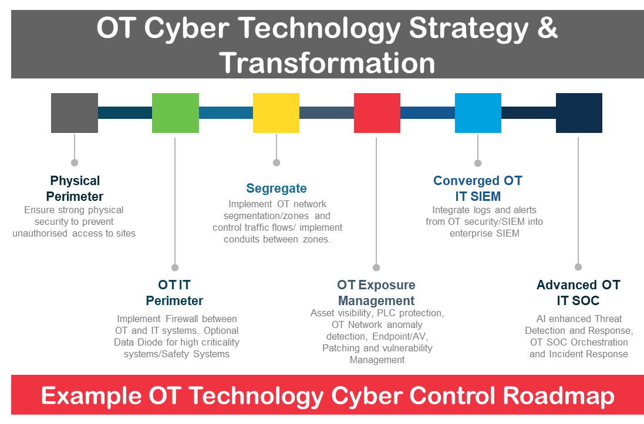
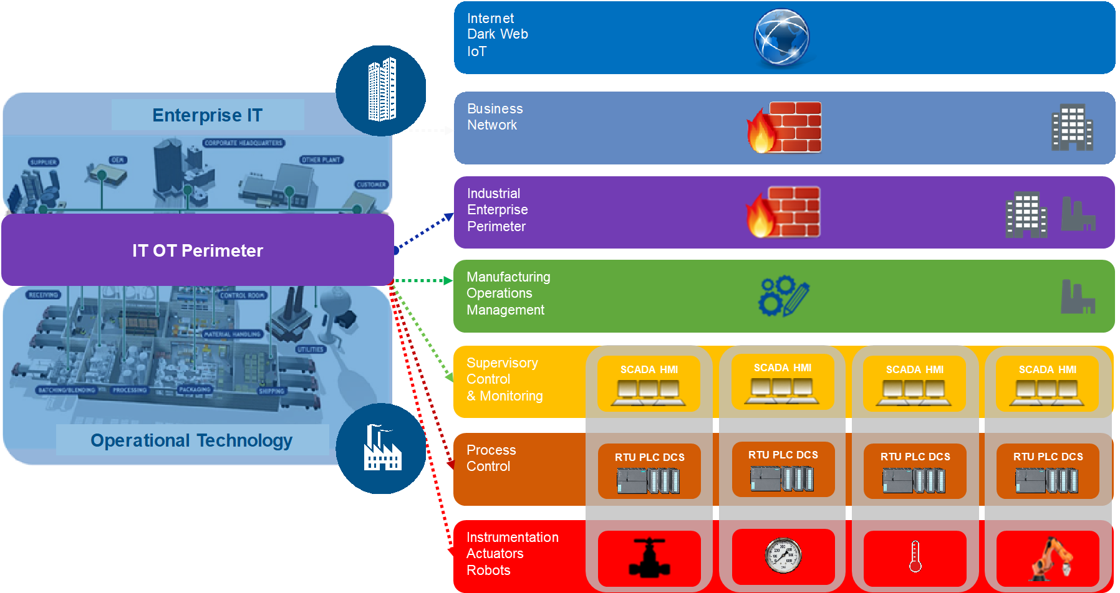
Our OT & IoT Security Services – Phase 3 – Protect
Assisting our clients manage the risks identified by developing a OT & IoT Cyber defence roadmap & governance model
Development of an OT & IoT Cyber security strategy and roadmap aligned to business priorities in conjunction with technology and business stakeholders
Encompass within the OT & IoT Cyber security strategy a proportional and pragmatic response to OT & IoT security controls aligned to regulatory compliance burden and any “customer licence to operate” requirement
Develop an enterprise and solution architecture leveraging Purdue network design to address OT & IoT cyber defence weaknesses
Benefits include:
Establishment of a cohesive approach to OT & IoT Security
Practical insights from globally experienced OT & IoT Security professionals with proven implementation
Scalable response aligned to business objectives
Notes:
Once the IDENTIFY and DETECT phases have been completed, we move to assisting our clients manage the risks identified by developing a OT & IoT Cyber defence roadmap & governance model. Consulting led, leveraging our sector specialised and geographically based onshore OT & IOT Security consulting subject matter experts, we help our clients:
Develop an OT & IoT Cyber security strategy and roadmap aligned to business priorities in conjunction with technology and business stakeholders
Encompass within the OT & IoT Cyber security strategy a proportional and pragmatic response to OT & IoT security controls aligned to regulatory compliance burden and any “customer licence to operate” requirement
Develop an enterprise and solution architecture leveraging Purdue network design to address OT & IoT cyber defence weaknesses including a business focussed operating model
Benefits include:
Establishment of a cohesive enterprise approach to OT & IoT Security
Practical insights from globally experienced OT & IoT Security professionals with proven implementation backgrounds in major Fortune 2000 organisations
Scalable response aligned to business objectives designed to enable Industry 4.0 business strategies whilst fulfilling baseline cybersecurity requirements

Slide 23

Preserving brand reputation through “OT & IoT Security by design”
Manufacturers of OT & IoT products and organisations reliant upon IoT devices to optimise efficient business operations through automated operating models will need to adopt a “Security by Design” approach to securing OT & IoT. Failure to adopt a risk and governance model for OT & IoT with “security and privacy by design” at its core will result in inevitable breaches occurring exposing the vulnerabilities which exist across technology landscapes, irrespective of IT, OT or IoT.
Cyber breaches of OT & IoT devices will likely lead to high profile incident reporting, brand reputation impact and loss of a “licence to operate” necessary to invoke and retain customer confidence in IoT and connected devices.
It is therefore evident that manufacturers and consumers of OT & IoT must ensure that they adopt OT & IoT Security practices to protect their organisational brand and enhance product growth initiatives.
Notes:
Manufacturers of OT & IoT products and organisations reliant upon IoT devices to optimise efficient business operations through automated operating models will need to adopt a “Security by Design” approach to securing OT & IoT.
Any failure to adopt a risk and governance model for OT & IoT with “security and privacy by design” at its core will result in inevitable breaches occurring exposing the vulnerabilities which exist across technology landscapes, irrespective of IT, OT or IoT. Cyber breaches of OT & IoT devices will likely lead to high profile incident reporting, brand reputation impact and loss of a “licence to operate” necessary to invoke and retain customer confidence in IoT and connected devices.
It is therefore evident that manufacturers and consumers of OT & IoT must ensure that they adopt OT & IoT Security practices to protect their organisational brand and enhance product growth initiatives. This will require a shift of security left in the development lifecycle and bring it to the heart of the business strategies and value chains that enable modern enterprise approaches embracing Industry 4.0 technologies.

Slide 24
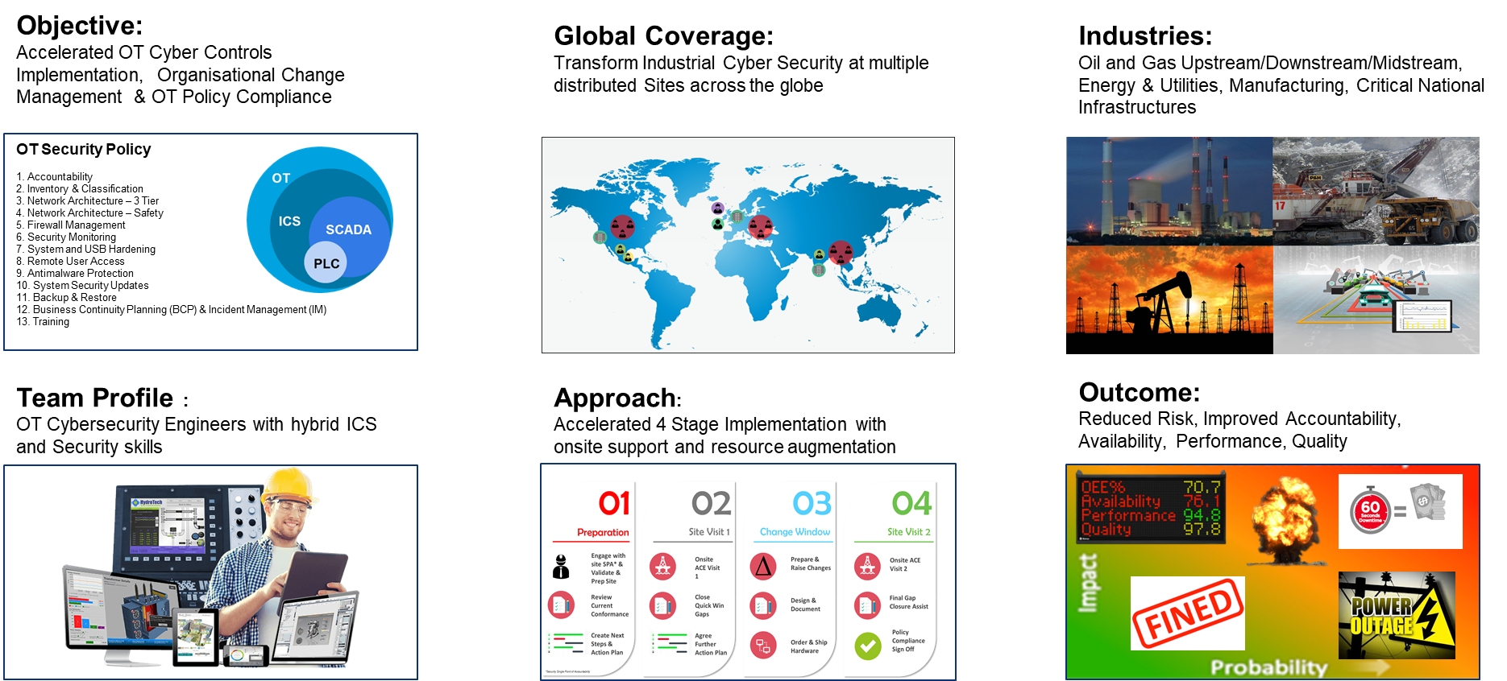
Our OT & IoT Security Services – Phase 4 – Respond
Assisting our clients manage the risks of OT & IoT cybersecurity in their organisation through systems integration led implementation of a new OT & IoT cybersecurity strategy
Notes:
Having established the PROTECT agenda it is imperative that organisations accelerate towards fulfilling the technology elements of OT & IoT security.
Our industry proven experience and capabilities allow us to accelerate an organisational response to the OT & IOT Security challenges. We have developed a response capability based on global coverage leveraging onshore, near-shore and offshore capabilities with a team almost 90% comprised of Fortune 2000 industrial experience.
This team profile and proven approach enables us to deliver expediently on desired business outcomes with confidence across numerous industries.

Slide 25
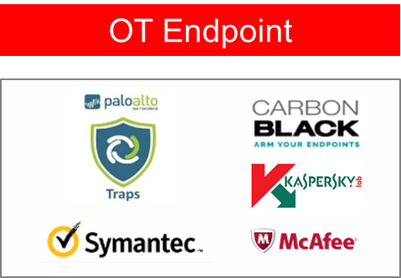
Our OT & IoT Security Services – Phase 4 – Respond
Assisting our clients manage the risks of OT & IoT cybersecurity in their organisation through deployment of OT & IoT security solutions
Managing the OT & IoT endpoint can be achieved using three routes:
Light weight agents compatible with out of support systems commonly found in OT & IoT environments
Cyber security solutions designed specifically for OT & IoT architectures
Hybrid systems combining IT, OT and IoT endpoint solutions
Threat | OT & IoT Endpoint Features
Unauthorized software execution | Whitelisting; prevention or detection-only (registration rather than blocking) modes
Malware | Advanced anti-malware signature-based detection engines; Cloud based detection engine
Cryptors, including ransomware | Anti-cryptor
Network attacks | Host-based firewall
Unauthorized device connection | Device control
Unauthorized wireless connections | Wi-Fi network control
PLC programs spoof | PLC integrity check
ICS specifics — airgaps; false positives for ICS software/process, etc. | Trusted updates, which tested with software of leading industrial vendors; certification of product by leading industrial automation vendors.
Notes:
In order to fulfil the RESPOND strategy, we focus on assisting our clients manage the risks of OT & IoT cybersecurity in their organisation through deployment of OT & IoT security solutions. We do this by managing OT & IoT endpoint security leveraging three routes:
Light weight agents compatible with out of support systems commonly found in OT & IoT environments
Cyber security solutions designed specifically for OT & IoT architectures
Hybrid systems combining IT, OT and IoT endpoint solutions deploying a converged approach to technology risk management
Through our extensive technology alliance partnerships we can either recommend new technical security solution strategies or align to existing client IT cyber security enterprise agreements thereby ensuring the best fit for client security requirements both in OT & IOT as well as the holistic technology risk environments and landscape.

Slide 26
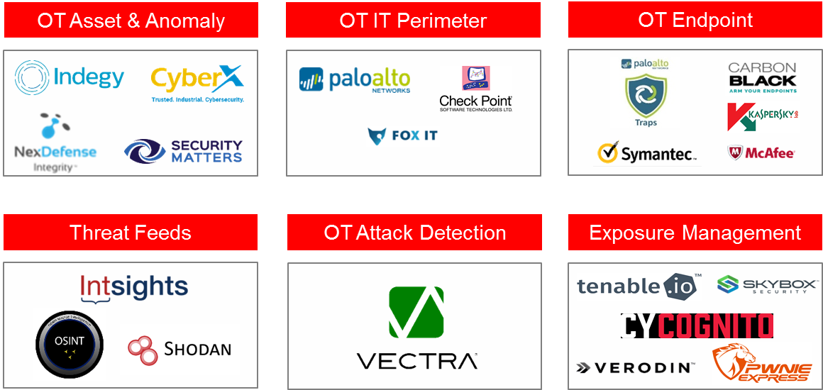
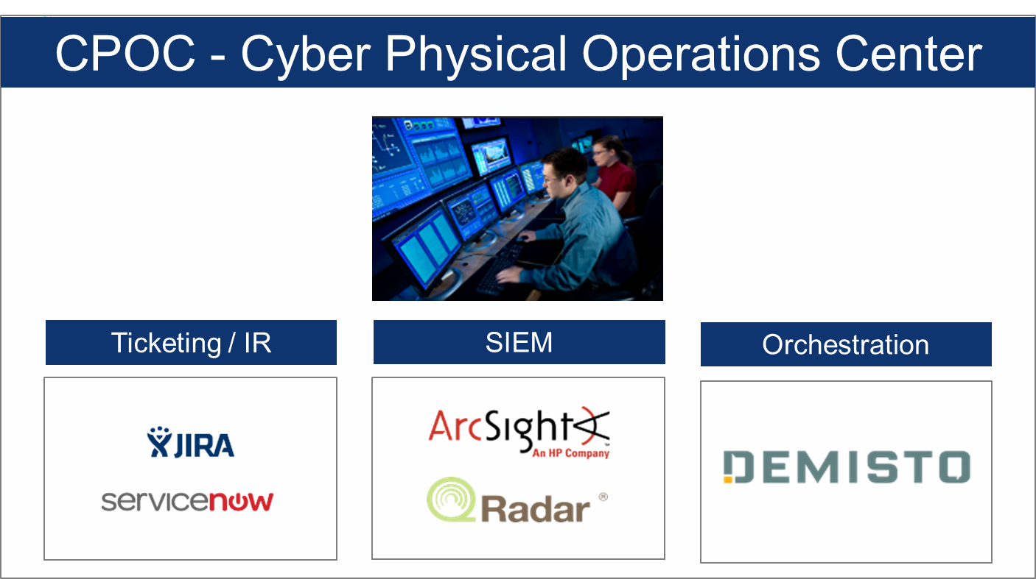
Our OT & IoT Security Services – Phase 5 – Recover
Sustainable global change delivered via world class technology partners
Assisting our clients achieve sustainable management of the risks of OT & IoT cybersecurity in their organisation through:
Advanced Industrial Security Operations enabling detection, protection and response to OT & IoT Cyber threats:
Security Incident & Event Management
Security Operations Centre
Security Orchestration
Managed Firewall and Endpoint
Cyber Threat Intelligence
Patch Management
Service design, build and operate of advanced OT & IoT Cybersecurity Services and Operations including Continuous L2 Control Monitoring of OT Assets
Benefits include:
Global coverage
Industrial Cybersecurity Expertise
Scalable and efficient managed services
Rapid Transformation of IT SOC into OT & IoT centric Cyber operations through SOAR
Notes:
Cumulatively through assisting our clients address the IDENTIFY, DETECT, PROTECT and RESPOND elements of their OT & IOT Security requirements, the final pillar of our support to enterprise clients is to help them achieve sustainable management of the risks of OT & IoT cybersecurity in their organisation through:
Advanced Industrial Security Operations enabling detection, protection and response to OT & IoT Cyber threats:
Security Incident & Event Management
Integrated IT, OT & IoT Security Operations Centre
Security Orchestration
Managed Firewall and Endpoint
Cyber Threat Intelligence
OT Security Patch Management
Service design, build and operate of advanced OT & IoT Cybersecurity Services and Operations including Continuous L2 Control Monitoring of OT Assets
Benefits of this RECOVER strategy include:
Global coverage
Industrial Cybersecurity Expertise
Scalable and efficient managed services
Rapid Transformation of IT SOC into OT & IoT centric Cyber operations through security orchestration

Slide 27


















Technology ecosystem
COMPANY Core Technology Partners
COMPANY “New-Age” Solution ecosystem

Slide 28
Key Objectives for OT SOC
To Build Global OT SOC management platform
Manages the response to OT Cyber Threats and Incidents
Monitors the Cyber Security posture and reports deficiencies
Performs Threat and Vulnerability Analysis
Performs Analysis of OT Cyber Security Events
Maintains an Internal Database of OT Cyber Security Incidents
Provide Alerts and Notifications to General and Specific Threats
Provide regular reporting to Management and OT Cyber Incident Responders
Reduce the response time of OT security incident from initial findings, to reporting to containment
Recovery Time Objective (RTO) in case of security incident materializing
Proactive OT Security Monitoring based on predefined security metrics / KPI
Raise Awareness of Information Security across community of leaders and sub-ordinates
Ability to correlate system, application, network, server, security logs in a consistent way
Ability to automate the requirement to meet compliance – vulnerability assessment and risk management
Ensure change control function is integrated into the SOC process
Identification for all security attack vectors and classification of incidents
Define disaster recovery plans for ICE (in-case of emergency).
Build a comprehensive reporting dashboard that is aligned to security metrics
Collaboration with CERTs
To build OT SOC processes that are aligned to existing ISO27001/IEC62443/NIST security policies
Build a physical and virtual team of SOC personnel for 24 x 7 monitoring
Build forensics capabilities to be able to reconstruct series of events during an incident
Proactive monitoring of network and security infrastructure devices

Slide 29
Typical Log sources
01
PLC/RTUs
Control plane process data.
Firmware/Configuration info
02
HMI/Servers
Application and process data.
Windows logs.
Real-time visibility on malicious activities, anomalies and unauthorized changes .
03
Anti-Virus
Malware info.
Breaches logs
04
2FA/LDAP
Remote access logs.
Access logs, login failures etc.
05
Firewall/IDS
Firewall logs
Anomalies
06
Network Switches
Network logs
PCAP
07
Threat Intel
Secure eye advisories, Dark web etc.
Threat hunting info, CVE, ICS CERT etc.
08
IT & Physical
Data from the corporate and Physical security systems
Notes:
Programmable Logic control

Slide 30
OT logging Challenges
Logs & Events
Technology Challenges
Embedded devices usually doesn’t support logging
Integrating operational logs from SCADA/DCS is challenging.
Floods of operational alerts and events leading to false positives
Unreliable Connectivity between different OT sites to collect the logs and integrate
Logs are in proprietary and unsupported formats
Difficult in implementing new technology solutions into existing OT environments
.
Security Maturity
People & Skill
Flat, unsegmented and non-mature ICS network
Unavailability of updated AS-IS diagrams, network architecture & asset inventory
Ad-hoc access control, network security, endpoint security, remote access etc.
Lack of Skilled resource with operational and security knowledge requirements
Cultural clash, collaboration issues, undefined SLAs between IT and OT security and operational requirements

Slide 31
Proposed Architecture for OT-Managed Security Platform

Slide 32
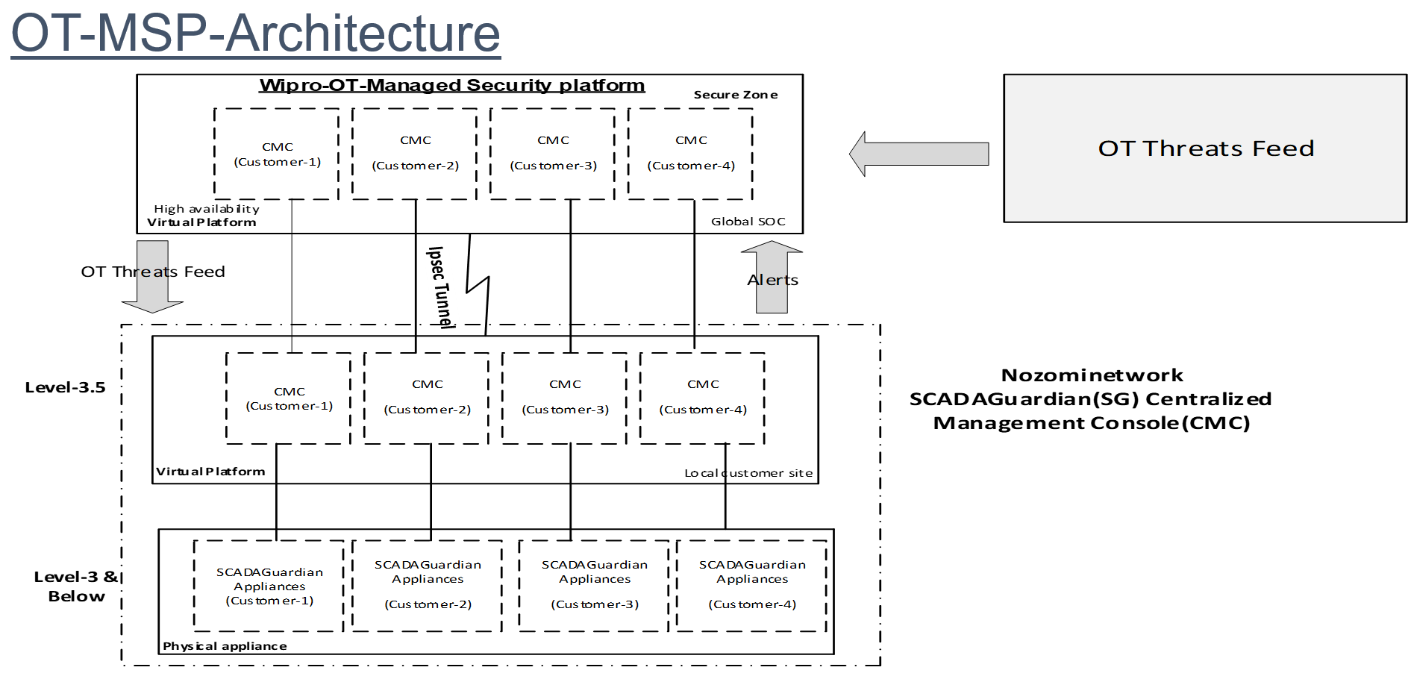

Slide 33
Typical single site deployment architecture

Slide 34
Logging/Monitoring Use Cases Overview
Visibility
Automated Asset Inventory along with asset details such as make, model, firmware version etc.
Security
Use of insecure protocols and protocol versions: Telnet, NTP, SSL, etc.
Continuity
Error responses from field devices such as PLCs and RTUs
Identify changes to critical controllers whether over the network or directly
Connectivity issues: weak and unstable network links
Misconfigured Client/Server: NTP, DNS and DHCP misconfigurations
Common Vulnerabilities and Exposures: use or exploit of known vulnerabilities
Malware: activity of known malware
Malfunctioning or misbehaving device: field devices with problems or misconfigurations
Potentially dangerous operation: e.g. device restart commands, frequent open/close commands
Loss of expected communication: long-lasting disconnection
Tracking of Modbus/TCP process variables (alert for sudden changes)

Slide 35
Additional Use cases
Specific Control plane activities detected over the network
-(e.g , code download, Firmware download, PLC start, PLC stop…)
Controller/PLC snapshot mismatch (controller code has been changed)
New asset discovered over the network & Asset disappeared from the network
Specific network/protocol/IP address as been detected over the network
Performance of critical assets by monitoring health indicators, e.g. disk storage remaining, excessive CPU usage, low memory and related counters
Detect and analyze all instances of abnormal behavior for user accounts with administrative privileges.
Detect and analyze port scanning attempts
Detects and alert any undesired (remote) access to network devices, such as for instance SSH, RDP and VNC access from/to unexpected hosts

Slide 36
IT/OT Convergence Model
Integrated IT OT SOC

Slide 37
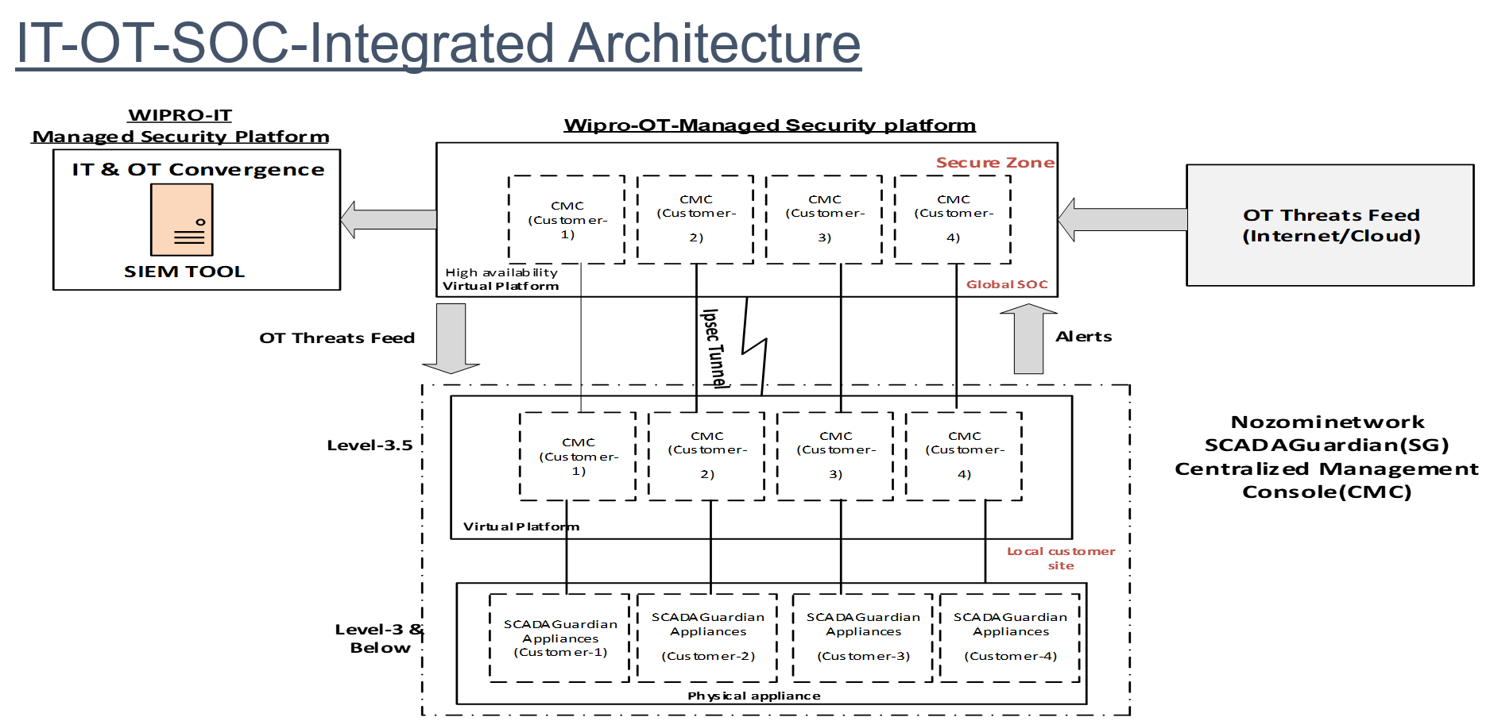
IT-OT-SOC-Integrated Architecture

Slide 38
High Level Implementation Approach
ICS Security Monitoring Solution Life-Cycle
Due-Diligence
Design
Build - Pilot
Build - Integrate
Global Transformation Program
Current State Review of ICS
Security Monitoring solution impact assessment
Review Asset Register
Review existing logging/monitoring controls in OT and Business network
Workshop / Discussion with OT device vendors
Implementation planning
Develop OT use cases
Solution blue print
Migration plan for brown field part of the OT network
Logging/Monitoring framework & strategy
Architecture Design
Testing, Roll-out and Operations Design
Roll-out of sensors/agents in ICS
Deploy log collectors in L3.5 in each of the pilot sites
Establish connectivity
Configure rules & policies for ICS traffic
Integrate with required cyber services
Monitor & Stabilize
Deploy ICS Log Aggregator & Monitoring solution in OT Security Centre (L3.5)
Configure correlation rules
Review & optimize use-cases
False positives elimination
Integration testing
Handover & Sign-off
Integration of all OT sites with global OT Security Centre
OT – IT Integration architecture for Logging
Establish integrated Cyber Physical SOC
Help Desk & Ticketing tool integration
Al – ML threat analysis
Deployment Requirements
SPAN port(s) needs to be configured receive traffic of the ICS network
Verify Spanning tree architecture with the network maintenance personnel prior to RSPAN configuration to avoid oversubscriptions.
Allocate Management port and static IP addresses for physical / virtual sensor appliances
Firewall rules needs to be configured for required TCP ports like #22, #443, syslog, NTP, LDAP etc.

Slide 39
High Level Approach

Slide 40
3 tier/stage model/approach
1st stage-We have already MSS platform for IT SOC ( Existing )
2nd stage-Build independent MSS platform for OT SOC ( To be accomplished)
3rd stage-Further integration between IT SOC & OT SOC .So that maintain independence, scalability & segregation, these 3 are most important key factors ( To be accomplished )
Depending on wide variety of customer requirements can offer both service model..
Independent OT-SOC service model ( includes both offshore & Onshore support services )
IT-OT Convergence Model ( This is typically of 2 different types.
Type 1) Already we have existing customer delivering IT SOC & customer wants further extension to OT.
Type 2) Customer wants IT & OT SOC services ( Fresh Requirement).

Slide 41
OT-SOC Service Model

Slide 42
Service Model
Onshore Delivery Model
Alerts/Data forwarded to Company Global OT SOC
24/7 Threat Monitoring through Global SG-CMC
OT-SOC Analysts sitting in Company secure cell/zone will have local access to Customer global CMC
No Company resources deployment at site
Offshore Delivery Model
Alerts/Data resides at customer premises
24/7 Monitoring through Local site SG-CMC
OT-SOC Analysts sitting in Company secure cell/zone gain remote access to customer site through jump server to provide 24/7 OT Threat Monitoring service
No company resources deployment at site
Less Risk & Cost effective

Slide 43
OT-SOC Service Offerings

Slide 44
OT_SOC Service offerings
24/7 centralized OT Threat Monitoring (continuous, Consolidated, Comprehensive )
Response to Cyber threats & Analysis of Cyber Incidents. Maintain an Internal Database of Cyber Security Incidents
2.Real time network Monitoring & visualization
(improves situational awareness) & Troubleshooting. Provide alerts & notifications to General & specific Threats
3.Asset Inventory Management
4.Vulnerability Management
Threat & Vulnerability analysis
5.Compliance Reporting
Regular reporting to Management and Cyber Incident Responders .Cyber security awareness.
6.Advisory

Slide 45
Service Offerings
ROAD MAP
BASE OFFERINGS

Slide 46
Nozomi SCADAGuardian Platform

Slide 47
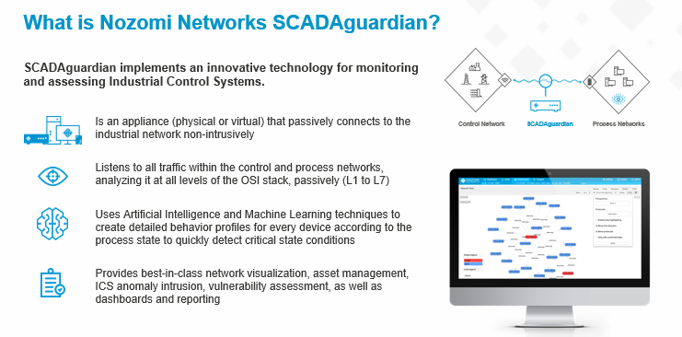
What is Nozominetworks SCADAGuardian ?

Slide 48
Technical Features
Real-time Cyber Security and Visibility for Industrial Control Networks
Nozominetworks SCADAguardian Tool Protect your control networks from cyberattacks and operational disruptions. It provides unprecedented operational visibility and rapid detection of cyber threats and process risks and does it in a completely passive way.
SCADAguardian automatically discovers your entire industrial network, including assets, connections, protocols and topology. It monitors network communications and behaviour for risks that threaten reliability and cyber security, and provides the information we need to respond quickly.
SCADAguardian delivers:
Superior asset identification, network visualization and real-time monitoring
Best-in-class ICS threat detection using a hybrid approach
Enterprise-class scalability when deployed with the Central Management Console
Easy integration and sharing of ICS and cyber security information with IT/OT infrastructure

Slide 49
Technical Features
Real-time Network Visualization
Improves system awareness and understanding of network structure and activity
Displays key information such as traffic throughput, TCP connections, or the protocols used between nodes and zones
Speeds incident response and troubleshooting efforts
Flexible Navigation and Filtering
Shows macro views + detailed information on endpoints and connections
Filters by subnets and network segments, or presents topologies
Up-to-Date Asset Inventory
Advances cyber resiliency and saves time with automated asset inventory
Provides detailed and verified asset information
Identifies all communicating assets*
Easy Asset Drilldown
Groups assets visually, as per the Purdue model, or in list views and detailed single asset summaries
Comprehensive Cyber Security and Reliability Monitoring
Improves network security and productivity through dashboards, charts and queries relevant to your organization
Monitors assets from all vendors and all network communications
Clear Presentation of Key Metrics
Displays summarized data related to alerts, incidents, vulnerabilities, etc.
Includes indicators of reliability issues such as unusual variable values

Slide 50
Technical Features
Easy Access to ICS Data
Summarizes ICS risk information for selected date and time ranges
Supports drilldown on visual indicators for detailed information
Queries any aspect of your network or ICS performance, reducing data collection and spreadsheet work
Up-to-the-Minute Threat Detection
Identifies cyber security and process reliability threats in real-time
Detects attacks in process, early stage advanced threats and cyber risks
Blocks attacks when integrated with compatible firewalls
Best-in-Class ICS Threat Detection
Uses multiple, hybrid techniques for comprehensive risk detection
Ensures current monitoring when integrated with OT Threat Feed subscription
Automated Vulnerability Assessment
Identifies which vendors’ devices are vulnerable
Utilizes the U.S. government’s NVD (National Vulnerability Database) for standardized naming, description and scoring

Slide 51
Technical Features
Reduce Troubleshooting and Forensic Efforts
Effective, Efficient Incident Response
Minimizes false positives with AI-powered Dynamic Learning
Decreases response time with Smart Incident™, which correlates alerts, provides operational context and delivers automatic packet captures
Informative Forensics
Decodes incidents with Time Machine™ system snapshots and diff reports (Snapshots are dynamic, allowing drilldown into rich ICS data.)
Provides answers fast with a powerful ad hoc query tool
Efficient Prioritization and Remediation
Speeds workflows with vulnerability dashboards and drilldowns
Addresses questions like “Do certain devices have vulnerable firmware?”
Easily Integrate / Share Information with IT/OT Environments
Integrated Security Infrastructure
Includes built-in integrations for asset management systems, firewalls, identity management systems, SIEMs and more
Extends further with an Open API

Slide 52
Technical Features
Quickly Achieve a Fast ROI with Our Easy-to-Deploy, Passive Solution
Swift Deployment
Requires no network changes and poses no risk to your industrial process
Installs as a proven, plug-and-play, ISO 9001: 2015 certified product
Rolls out across multiple sites in days and weeks versus months and years
Immediately Valuable
Improves ICS visibility, cyber security and reliability
Increases productivity and IT/OT collaboration
Broad Protocol Support
Supports dozens of ICS and IT protocols
Includes Protocol SDK for quick addition of new protocols
Best-in-Class ICS Threat Detection
Enterprise Ready
Identifies risks with rules (Yara Rules, Packet Rules and Assertions), used for detecting known malware and the early stages of advanced persistent threats
Identifies risks with behaviour-based anomaly detection, used for detecting new and zero-day attacks, as well as process risks

Slide 53
Technical Features
Timely Threat Mitigation
Uses advanced correlation and operational context to provide detailed insights that lead to rapid remediation
Warns of potential issues or attacks immediately, providing the maximum opportunity to avoid or mitigate problems
Up-to-Date Threat Monitoring with Optional OT Threat Feed
Timely Threat Updates
Provides indicators of emerging threats and vulnerabilities
Curates, tests and adapts ICS threat information from multiple sources, including threats and vulnerabilities discovered by NozomiNetworks
Makes it easy and efficient to stay on top of current ICS risks

Slide 54

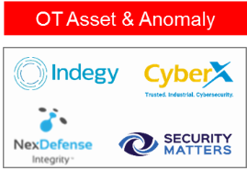

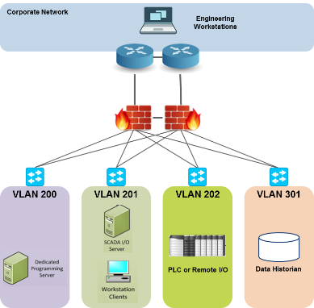




OT Network IDS: Asset & Anomaly Detection
OT Specific SCADA security monitoring solution - NOT traditional IDS
PASSIVE Deep Packet Inspection for ICS networks
Full visibility into all OT activity, asset details, network behavior etc.
Supports Industrial protocols & applications
Real-time alerts on suspicious and unauthorized access to controllers
Baseline deviations
ICS protocol violations
Unusual behavior
Detected malware
Operational issues
Incident response, investigations & forensics
Integration with existing security stack (SIEMs, firewalls, ticketing, secure remote access, etc.)
SIEM & SOC
ALERTS & ANALYSIS
OT SENSOR
VULNERABILITY
MANAGEMENT
OT ASSETS

Slide 55
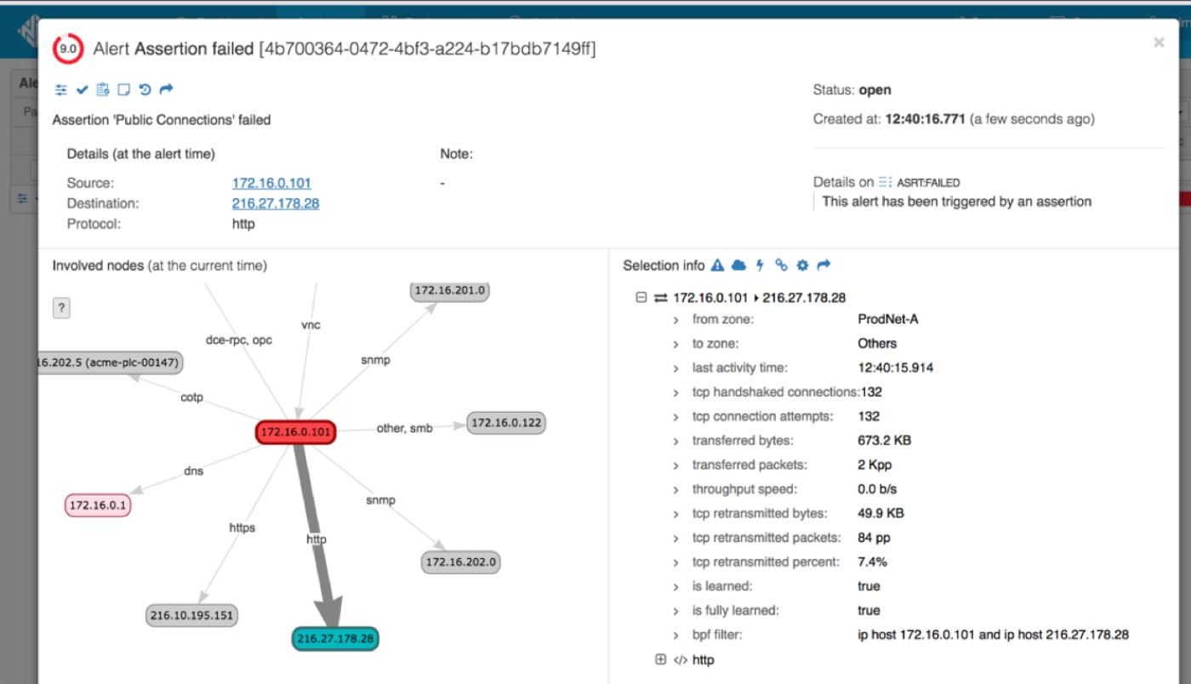
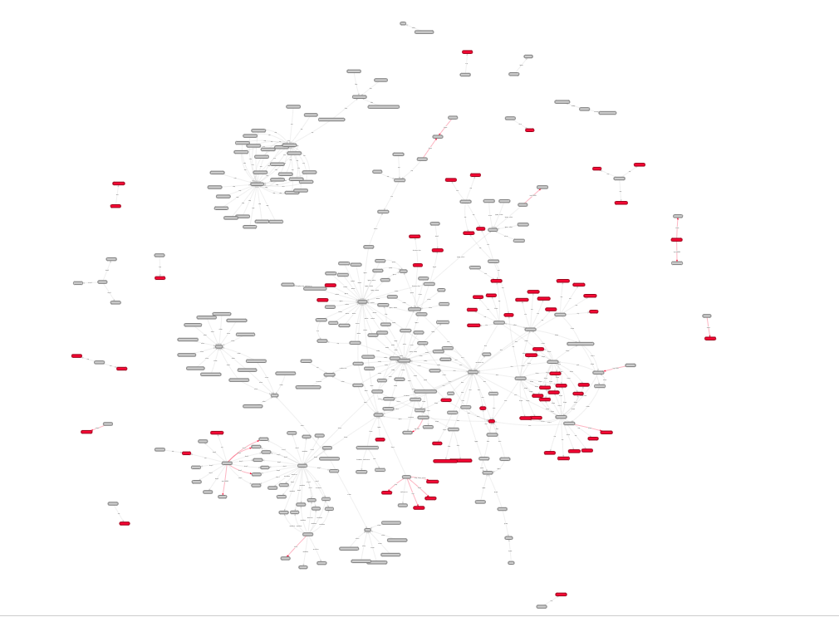
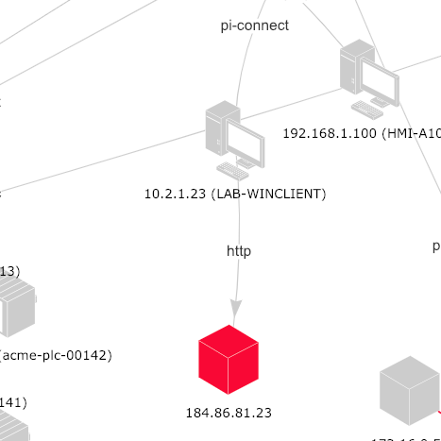
Level-1/2 devices connected to Internet

Slide 56
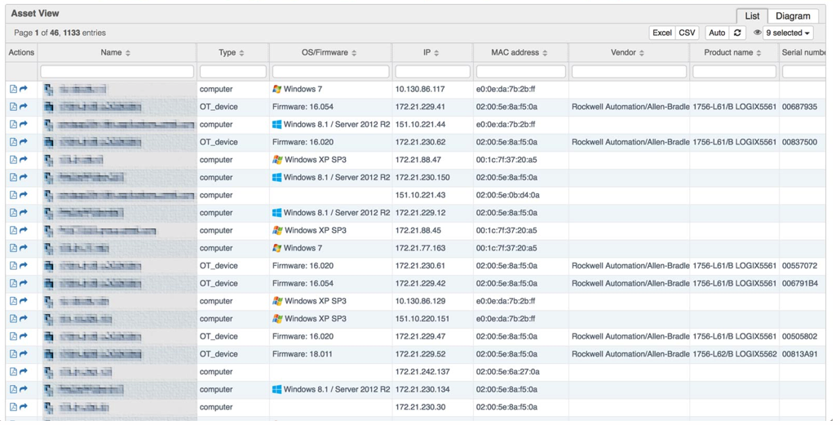
Wide Variety of OS/Firmware Versions… even on devices deployed together

Slide 57
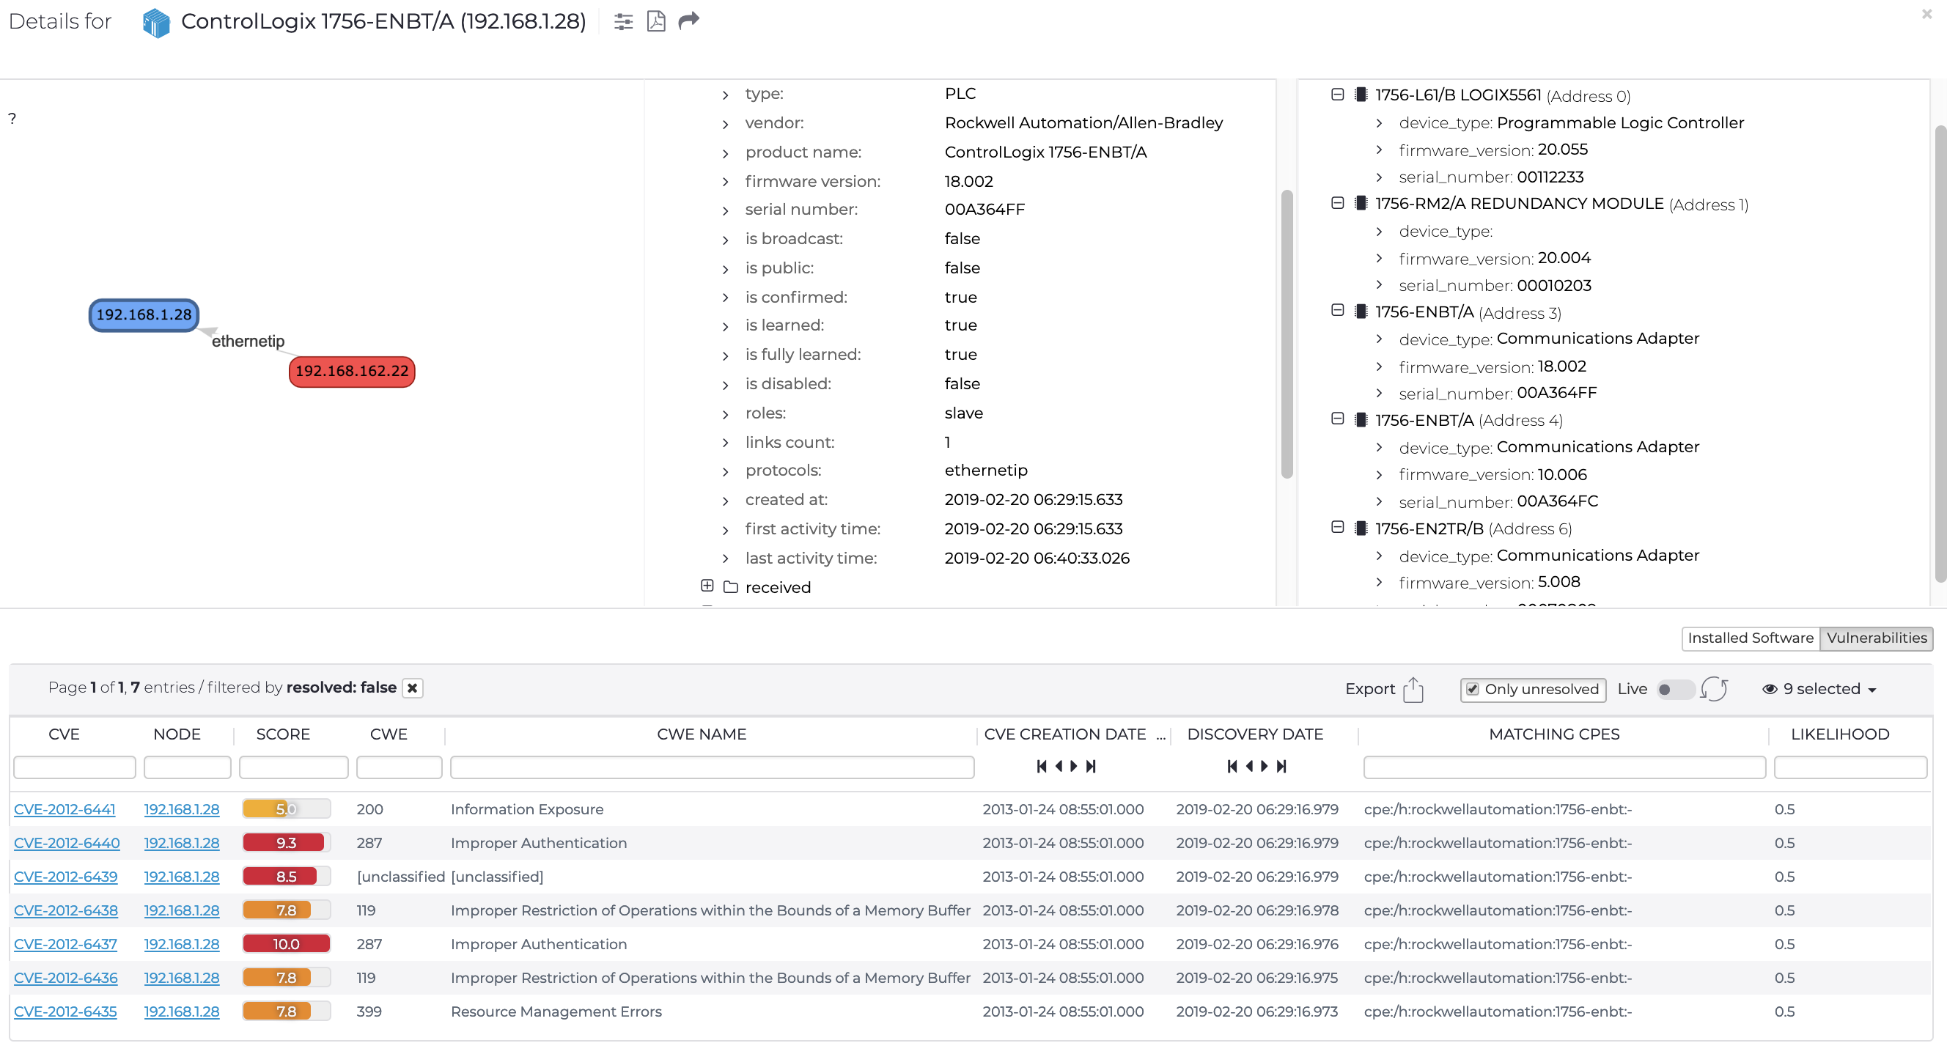
Software / Firmware Vulnerabilities

Slide 58
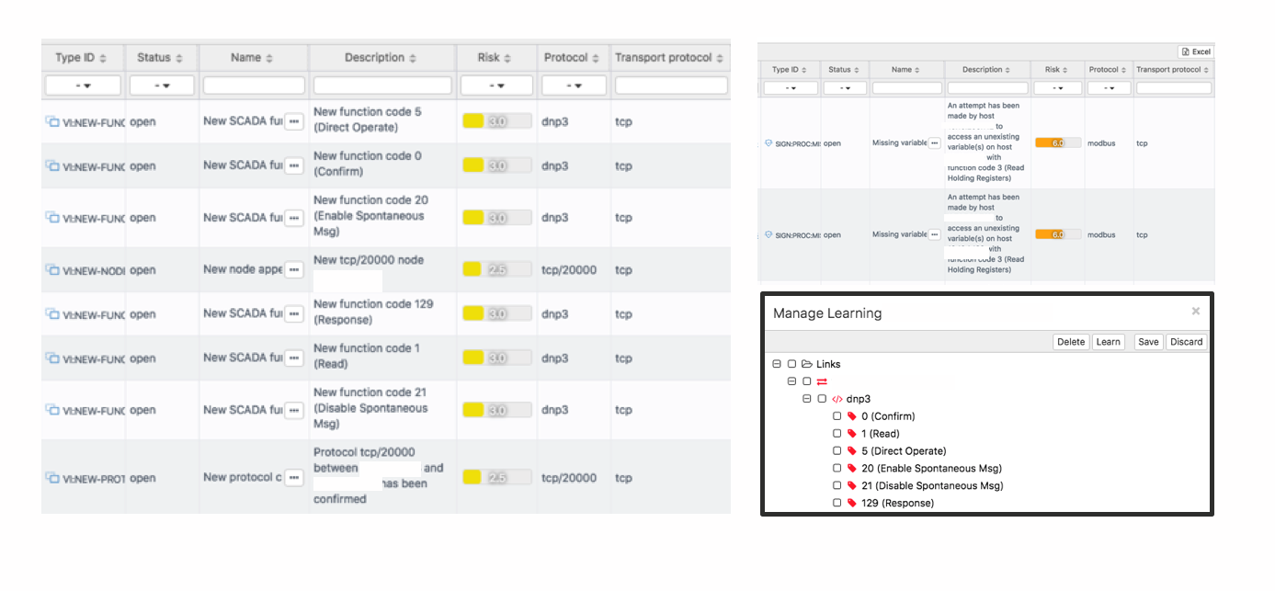
Unknown / Misconfigured Devices

Slide 59
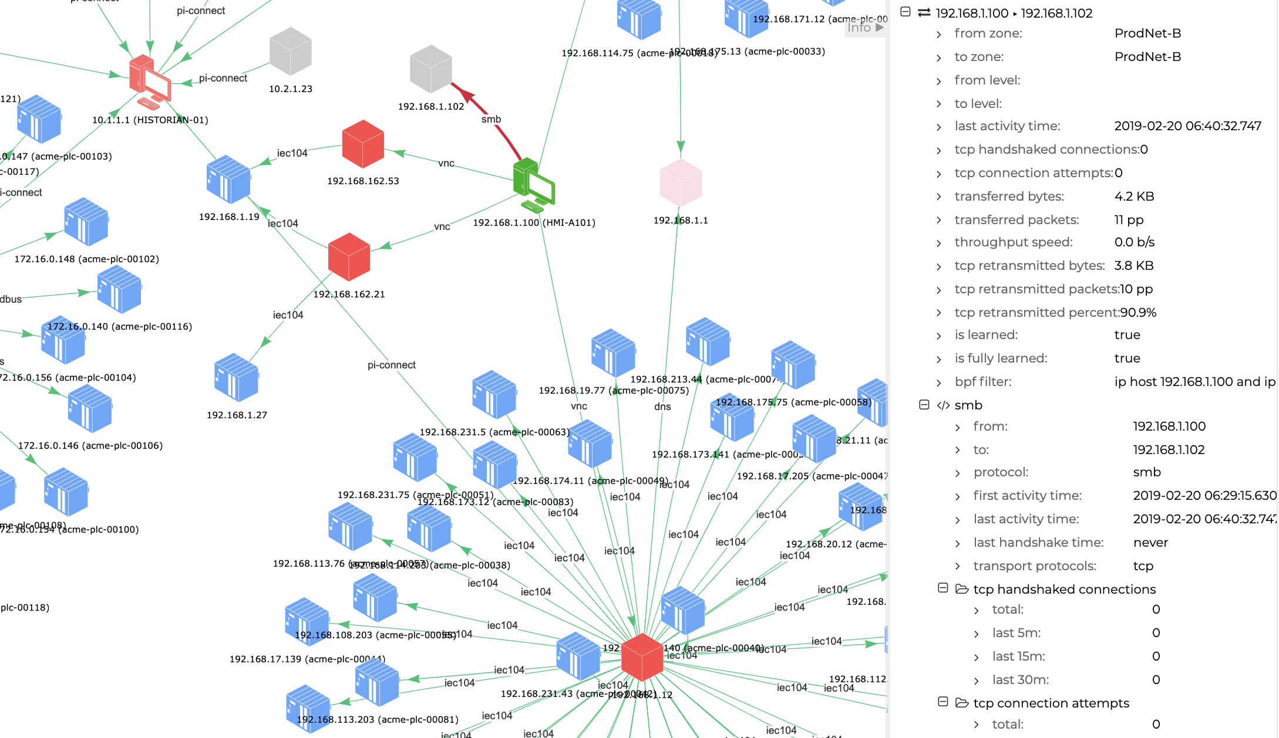
Serious Networking Issues

Slide 60
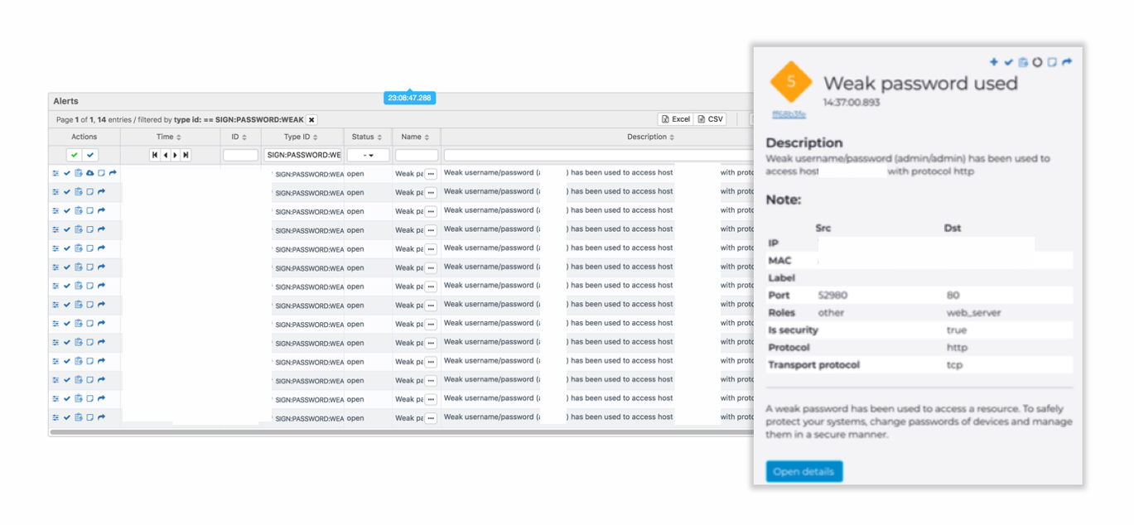
Unencrypted / Weak Credentials

Slide 61
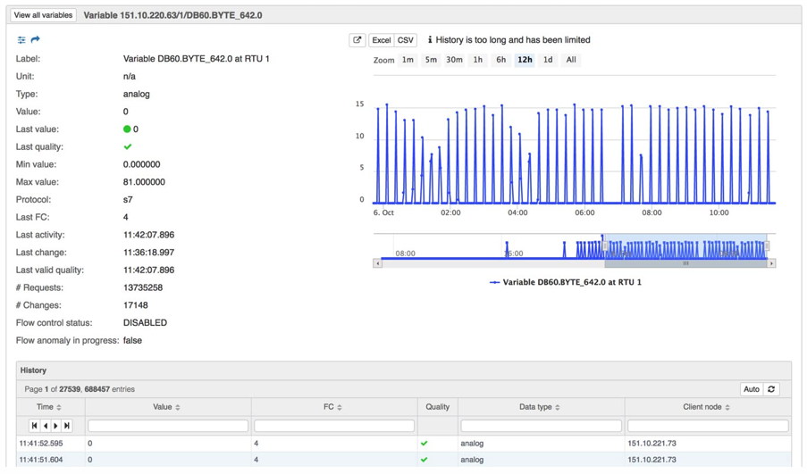
Abnormal Device Operation

Slide 62
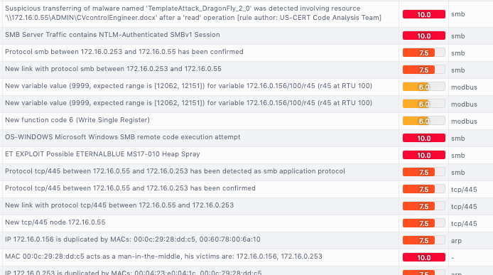
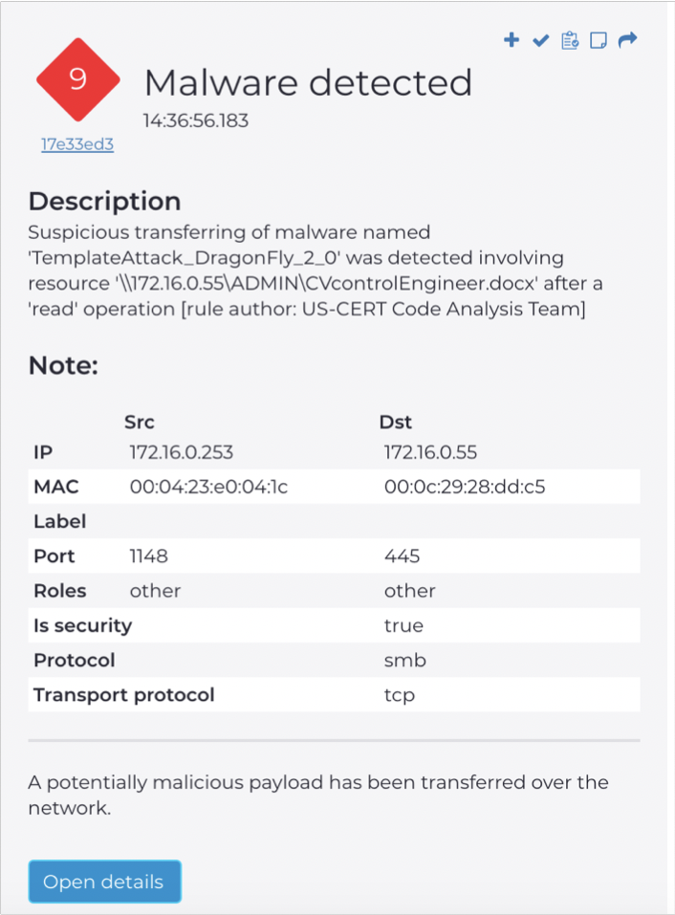
Not unheard of – already infected networks

Slide 63
Summary
Visibility: Process, Assets, Network
Cyber threat defense: Signatures, File dissection, Behavior based, AI driven detection and Assertions
Predictive maintenance: Trouble shooting, Early indications, Ghost drift.
Lack of complexity: NO agent, NO change in topology and NOTHING in line. Passive with active option.
Provides a wide array of compliance for a regulatory standards
Strong presence: Sales, Pre-sales, Delivery, existing referenceable customers in region

Slide 64
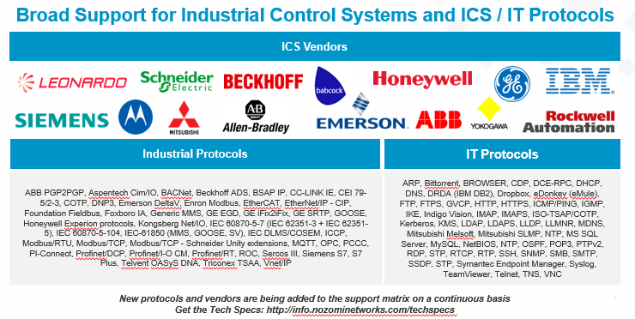
ICS Support

Slide 65
Thank You

